Slide 1

LTV DATA SCIENCE - PRESENTATION PROMPT
.
Notes:
The Objective of this research
To forecast the construction of SFHs in United States, so that it guide construction business community about where to invest ahead of time. Past data can be used analyze complex patterns in SFHs construction across united states (US)
Once we get the prediction, now it is important to know the optimal locations where construction company build plants

Slide 2
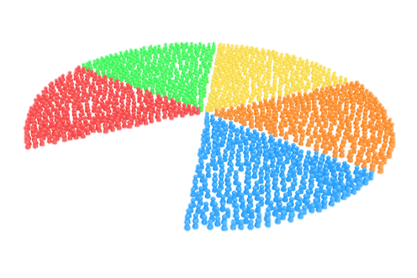

A well-known customer success law, the Pareto principle says that repeat customers generate revenue that is nearly 16 times more efficient than one-time customers. The potency of 80/20 is that 20 percent of a group is responsible for 80 percent of the sales.
Customers’ 80/20 Rule
.
Notes:
The Objective of this research
To forecast the construction of SFHs in United States, so that it guide construction business community about where to invest ahead of time. Past data can be used analyze complex patterns in SFHs construction across united states (US)
Once we get the prediction, now it is important to know the optimal locations where construction company build plants

Slide 3
Agenda
Why we need CLTV?
What type of Data we Need?
What Use Cases Possible for Daily Harvest?
Customer Segmentation
Rule Base Association Mining (Market Basket Analysis)
Demand Forecasting/ Next Purchase Model
Customer Life Time Value
Customer Churn Analysis
Notes:
The Objective of this research
To forecast the construction of SFHs in United States, so that it guide construction business community about where to invest ahead of time. Past data can be used analyze complex patterns in SFHs construction across united states (US)
Once we get the prediction, now it is important to know the optimal locations where construction company build plants

Slide 4
Dataset Required
We can have a lot of insights when we have good quality, multiple features data, but on minimum we need following data of customers.
Customers’ Data
(Address, Age, Likes, Dislikes etc.)
Customers’ Transactional Data
(Customer ID, Order Date, Items, Price)
Notes:
The Objective of this research
To forecast the construction of SFHs in United States, so that it guide construction business community about where to invest ahead of time. Past data can be used analyze complex patterns in SFHs construction across united states (US)
Once we get the prediction, now it is important to know the optimal locations where construction company build plants

Slide 5
Dataset Required
We can have a lot of insights when we have good quality, multiple features data, but on minimum we need following data of customers.
Customers’ Data
(Address, Age, Likes, Dislikes etc.)
Customers’ Transactional Data
(Customer ID, Order Date, Items, Price)
This type of data help us to make Recommendation System, which will recommend Daily Harvest items to users as per their preferences and past behavior.
Notes:
The Objective of this research
To forecast the construction of SFHs in United States, so that it guide construction business community about where to invest ahead of time. Past data can be used analyze complex patterns in SFHs construction across united states (US)
Once we get the prediction, now it is important to know the optimal locations where construction company build plants

Slide 6
Dataset Required
We can have a lot of insights when we have good quality, multiple features data, but on minimum we need following data of customers.
Customers’ Data
(Address, Age, Likes, Dislikes etc.)
Customers’ Transactional Data
(Customer ID, Order Date, Items, Price)
This type of data help us to make following systems;
Customer Segmentation (Help us to avoid Customer Churn & increase Retention)
Market Basket Analysis (Help us to know product’s mutual association)
Customer Life Time Value (Help us to know our Best and Loyal Customers)
Customers’ Demand Prediction Model (Potential Incoming Customers)
Notes:
The Objective of this research
To forecast the construction of SFHs in United States, so that it guide construction business community about where to invest ahead of time. Past data can be used analyze complex patterns in SFHs construction across united states (US)
Once we get the prediction, now it is important to know the optimal locations where construction company build plants

Slide 7
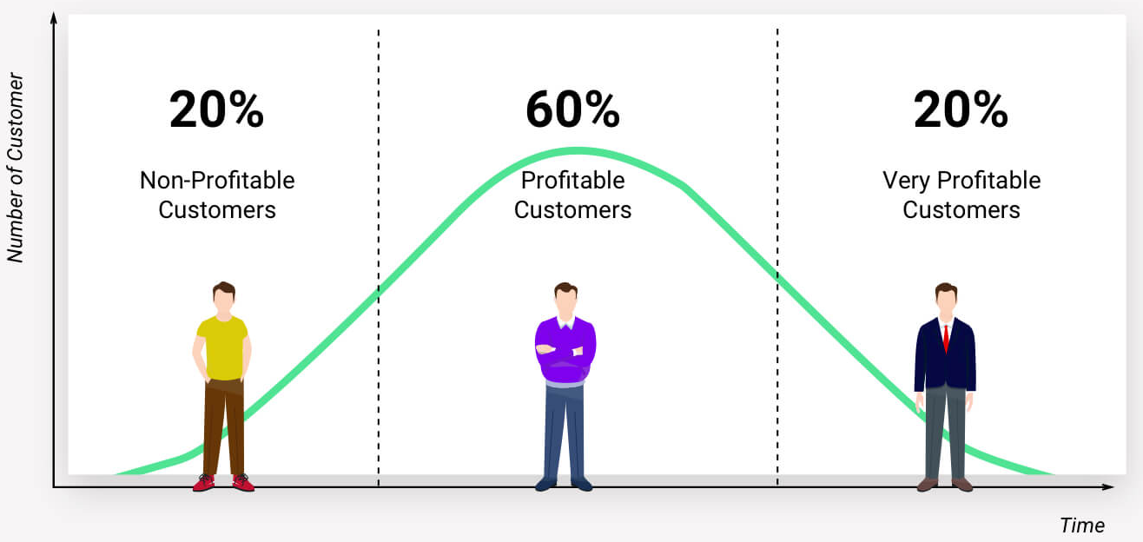
Part 1 - Customer Life Time Value (CLTV)
.
Notes:
The Objective of this research
To forecast the construction of SFHs in United States, so that it guide construction business community about where to invest ahead of time. Past data can be used analyze complex patterns in SFHs construction across united states (US)
Once we get the prediction, now it is important to know the optimal locations where construction company build plants

Slide 8
Possible Use Cases at Daily Harvest
Customer Life Time Value (LTV)
Not all customers are created equal.
It is type of Value-based segmentation, which differentiates customers by their economic value, grouping customers with the same value level into individual segments that can be distinctly targeted
CLV gives you crucial insight into how much money you should be spending on acquiring your customers by telling you how much value they’ll bring to your business in the long run.
Two approaches for LTV
Historical Approach
Predictive Approach
Notes:
The Objective of this research
To forecast the construction of SFHs in United States, so that it guide construction business community about where to invest ahead of time. Past data can be used analyze complex patterns in SFHs construction across united states (US)
Once we get the prediction, now it is important to know the optimal locations where construction company build plants

Slide 9

We invest in customers (acquisition costs, offline ads, promotions, discounts & etc.) to generate revenue and be profitable. Naturally, these actions make some customers super valuable in terms of lifetime value but there are always some customers who pull down the profitability. We need to identify these behavior patterns, segment customers and act accordingly
Why We Need CLTV?
.
Notes:
The Objective of this research
To forecast the construction of SFHs in United States, so that it guide construction business community about where to invest ahead of time. Past data can be used analyze complex patterns in SFHs construction across united states (US)
Once we get the prediction, now it is important to know the optimal locations where construction company build plants

Slide 10

Customer Life Time Value
Aggregate Model
Aggregate Model
Calculating LTV by using the average revenue per customer based on past transactions
This method gives us a single value for the CLV. This is not detailed approach (give a single value), because it give us aggregated value for each customer.
Not all customers are same in term of monetary value
Cohort Model
Instead of simply assuming all the customers to be one group, we can try to split them into multiple groups and calculate the CLV for each group.
This model overcomes the major drawback of the simple Aggregate model which assumes the entire customers as a single group.
his help us to find successful marketing campaigns, products and other strategies like posting on Facebook, Social Media, Discounts etc.
Notes:
The Objective of this research
To forecast the construction of SFHs in United States, so that it guide construction business community about where to invest ahead of time. Past data can be used analyze complex patterns in SFHs construction across united states (US)
Once we get the prediction, now it is important to know the optimal locations where construction company build plants

Slide 11
Customer Life Time Value
Predictive Approach
Machine Learning Model
Using regression techniques to fit on past data to predict the LTV
We need to make dataset for this
Probabilistic Model
It tries to fit a probability distribution to the data and estimates the future count of transactions and monetary value for each transaction.
LIFETIMES is an open source Python Library I will be using for Calculating LTV
Notes:
The Objective of this research
To forecast the construction of SFHs in United States, so that it guide construction business community about where to invest ahead of time. Past data can be used analyze complex patterns in SFHs construction across united states (US)
Once we get the prediction, now it is important to know the optimal locations where construction company build plants

Slide 12

RFM For Daily Harvest
Customer Segmentation
Customer segmentation is the process by which you divide your customers up based on common characteristics – such as demographics or behaviors, so you can market to those customers more effectively. These customer segmentation groups can also be used to begin discussions of building a marketing persona.
RFM
Recency : The duration between a daily harvest customer's first purchase and their latest purchase
Frequency: How many orders placed by Daily Harvest’s customer ID per year
Monetary: What revenue generated by Harvest’s customer ID per year)
Note: These factors will help Daily harvest understand different customers behavior and segment customers by calculating an RFM score for each customer ID in their database.
Based on this segmentation, Daily Harvest can create different retention strategies according to the particularities of each customer segment group.
Notes:
The Objective of this research
To forecast the construction of SFHs in United States, so that it guide construction business community about where to invest ahead of time. Past data can be used analyze complex patterns in SFHs construction across united states (US)
Once we get the prediction, now it is important to know the optimal locations where construction company build plants

Slide 13
Daily Harvest has a subscription service that sends healthy, pre-portioned superfood eats to customer home either weekly or monthly. Daily Harvest customers have customer ID.
Approach to predicting the lifetime value (LTV) of DH customers
.
RFM (Recency, Frequency, and Monetary value) Metrics is what I will used in predicting the lifetime value (LTV) of Daily Harvest customers, each corresponding to some key customer trait.
These RFM metrics are important indicators of a customer's behavior because frequency and monetary value affects a customer's lifetime value, and Recency affects retention, a measure of engagement.
Notes:
The Objective of this research
To forecast the construction of SFHs in United States, so that it guide construction business community about where to invest ahead of time. Past data can be used analyze complex patterns in SFHs construction across united states (US)
Once we get the prediction, now it is important to know the optimal locations where construction company build plants

Slide 14
Define an appropriate time frame for Customer Lifetime Value calculation
Approach to predicting the lifetime value (LTV) of DH customers
.
Appropriate time frame for daily harvest is one year
Calculate the RPM score for each customer ID and use the value to divide the daily harvest customer ID into 3 segment group:-
Low LTV: Daily Harvest Customers who are less active than others, not very frequent buyer/visitor and generates very revenue.
Mid LTV: In the middle of everything. Often using daily harvest site (but not as much as our High Values), fairly frequent and generates moderate revenue.
High LTV: The group of daily harvest customers we don’t want to lose. High Revenue, Frequency and low Inactivity, always renew subscription.
Notes:
The Objective of this research
To forecast the construction of SFHs in United States, so that it guide construction business community about where to invest ahead of time. Past data can be used analyze complex patterns in SFHs construction across united states (US)
Once we get the prediction, now it is important to know the optimal locations where construction company build plants

Slide 15
These customers have proven to have a higher willingness to pay, so don't use discount pricing to generate incremental sales. Instead, focus on value added offers through Product recommendations based on previous purchases and also Consider premium offers, subscription tiers
Daily Harvest’s 3 Segments LTV Marketing Strategies
.
HIGH LTV CUSTOMERS
Focus on loyalty programs and new product introductions
Notes:
The Objective of this research
To forecast the construction of SFHs in United States, so that it guide construction business community about where to invest ahead of time. Past data can be used analyze complex patterns in SFHs construction across united states (US)
Once we get the prediction, now it is important to know the optimal locations where construction company build plants

Slide 16
Marketing Strategies: Having clear strategies in place for Low LTV Daily harvest customers ID such as triggered reminder emails, phone numbers will pay dividends
Daily Harvest’s 3 Segments LTV Marketing Strategies
.
LOW LTV CUSTOMERS
Marketing Strategies: Focus on increasing monetization through daily harvest product recommendations based on past purchases
MID LTV CUSTOMERS
Notes:
The Objective of this research
To forecast the construction of SFHs in United States, so that it guide construction business community about where to invest ahead of time. Past data can be used analyze complex patterns in SFHs construction across united states (US)
Once we get the prediction, now it is important to know the optimal locations where construction company build plants

Slide 17
Varying Tenures
When you have varying tenures of customers, then it is better to calculate the LTV, RFM and other use cases discussed here, on multiple time frames. For example let say, LTV values
Calculate LTV values for customers at each month
Evaluate how customer increase sale or decrease sale, you can evaluate many patterns/ behavior of customer from this
You can easily evaluate which customers are churned or about to churn using Exploratory Data Analysis and statistical analysis
You can have better idea about your service/ products – those products can be easily identified which cause customer to churn
You can have better marketing strategy
Notes:
The Objective of this research
To forecast the construction of SFHs in United States, so that it guide construction business community about where to invest ahead of time. Past data can be used analyze complex patterns in SFHs construction across united states (US)
Once we get the prediction, now it is important to know the optimal locations where construction company build plants

Slide 18
Customer Life Time Value
Python Lifetimes
https://lifetimes.readthedocs.io/en/latest/
Lifetimes can be used to analyze your users based on a few assumption:
Users interact with you when they are “alive”.
Users under study may “die” after some period of time.
Applications
Predicting how often a visitor will return to your website. (Alive = visiting. Die = Churned)
Understanding how frequently a patient may return to a hospital. (Alive = visiting. Die = maybe the patient moved to a new city, or became deceased.)
Predicting individuals who have churned using only their usage history. (Alive = logins. Die = removed the app)
Predicting repeat purchases from a customer. (Alive = actively purchasing. Die = became disinterested with your product)
Predicting the lifetime value of your customers
Notes:
The Objective of this research
To forecast the construction of SFHs in United States, so that it guide construction business community about where to invest ahead of time. Past data can be used analyze complex patterns in SFHs construction across united states (US)
Once we get the prediction, now it is important to know the optimal locations where construction company build plants

Slide 19
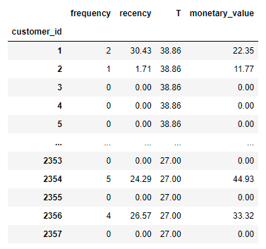
Other Way for LTV Calculation
Customer Life Time Value – (I am using other dataset as Daily Harvest’s Data is Missing Main Columns in data which are Transaction Date and Price of Item (Monetary) )
Step 1: I will transform Daily Harvest’s Data into given form
Customer Unique ID – For Calculating LTV
Important Thing about Calculating LTV – We always Select Specific Time Frame like selecting transactions of whole year or a month.
Frequency – Total Orders by Customers
Recency – Today’s Order Date Minus Last Order Date
Monetary – Total Transactions and Revenue by Specific Customer
Notes:
The Objective of this research
To forecast the construction of SFHs in United States, so that it guide construction business community about where to invest ahead of time. Past data can be used analyze complex patterns in SFHs construction across united states (US)
Once we get the prediction, now it is important to know the optimal locations where construction company build plants

Slide 20
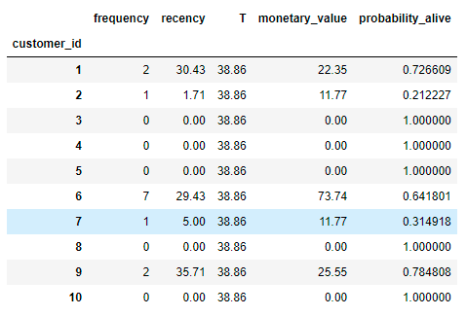
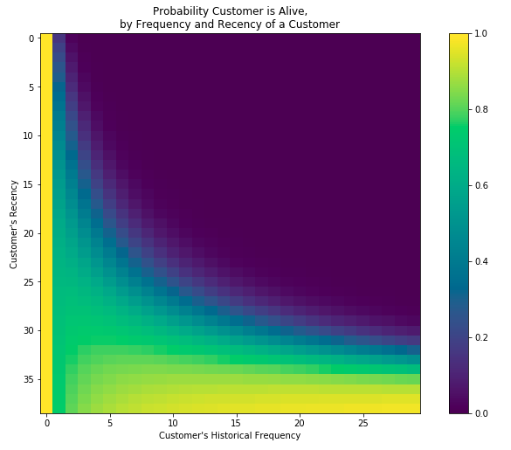
Working with your Data
Customer Life Time Value – (I am using other dataset as Daily Harvest’s Data is Missing Main Columns in data which are Transaction Date and Price of Item (Monetary) )
Step 2: Using Lifetimes Calculate the Probability of Alive (for each Customer)
http://www.brucehardie.com/notes/021/palive_for_BGNBD.pdf
Notes:
The Objective of this research
To forecast the construction of SFHs in United States, so that it guide construction business community about where to invest ahead of time. Past data can be used analyze complex patterns in SFHs construction across united states (US)
Once we get the prediction, now it is important to know the optimal locations where construction company build plants

Slide 21
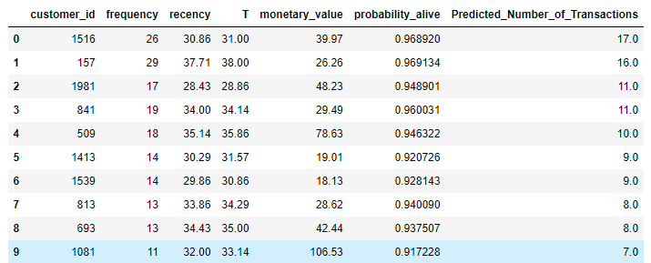
Working with your Data
Customer Life Time Value – (I am using other dataset as Daily Harvest’s Data is Missing Main Columns in data which are Transaction Date and Price of Item (Monetary) )
Step 3: Predict Number of Transactions in next 30 or X days using Conditional Probability (for each Customer)
http://brucehardie.com/papers/018/fader_et_al_mksc_05.pdf
Notes:
The Objective of this research
To forecast the construction of SFHs in United States, so that it guide construction business community about where to invest ahead of time. Past data can be used analyze complex patterns in SFHs construction across united states (US)
Once we get the prediction, now it is important to know the optimal locations where construction company build plants

Slide 22
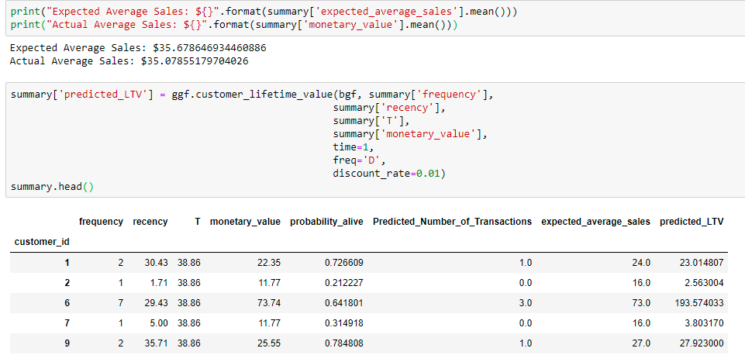
Working with your Data
Customer Life Time Value – (I am using other dataset as Daily Harvest’s Data is Missing Main Columns in data which are Transaction Date and Price of Item (Monetary) )
Step 4: Calculate LTV for each Customer using Gamma Gamma Fitter (Statistical Method)
Notes:
The Objective of this research
To forecast the construction of SFHs in United States, so that it guide construction business community about where to invest ahead of time. Past data can be used analyze complex patterns in SFHs construction across united states (US)
Once we get the prediction, now it is important to know the optimal locations where construction company build plants

Slide 23
How LTV Impact Marketing?
You will always have to spend money to acquire new customers and retain old ones. In fact, acquiring new customers costs almost five times more than retaining existing ones. Moreover, while the probability of selling to an existing customer is 60-70%, the chance of selling to a new customer is just 5-20%.
By clearly estimating LTV, marketing teams can focus more on targeting qualified leads who can be easily acquired with the lowest costs. For instance, spending $10 acquiring a lead that ends up buying more than $500 of products may seem like a great bargain. But what if your close ratio was 5%? You would have to spend $10 x 20 leads = $200 just for acquiring one customer who would buy your product worth $500.
A clear LTV helps set the maximum marketing budget for both acquiring new customers, and for maintaining relationships with existing ones.
It is also important for marketing teams to understand that, just like there isn’t a simple target segment, there also isn’t just a single LTV number. Instead, they need to segment their marketing efforts according to the value of the target customer segment.
Notes:
The Objective of this research
To forecast the construction of SFHs in United States, so that it guide construction business community about where to invest ahead of time. Past data can be used analyze complex patterns in SFHs construction across united states (US)
Once we get the prediction, now it is important to know the optimal locations where construction company build plants

Slide 24
How to Increase LTV?
Optimize Onboarding - It’s important to make the first impression positive. Customers often need education on the features and benefits of your product to truly understand how the product can positively impact their live – Do effective onboarding
Listen to your Customers – Customer appreciate when their voices are heard – Get weekly/ monthly feedback from users, online survey, ask them what else you need, launch custom products
Loyalty Program - Implementing a loyalty program can be a great way to personalize the customer experience while incentivizing repeat purchases. Some common loyalty programs offer reward points, or the ability to unlock free and discounted product after the accumulation of purchases. For example, buy nine Smoothees and get the tenth free
Retargeting - One of the most important tactics to improve customer lifetime value is to re-engage customers who have had a previous experience with the brand. Retargeting can be a simple reminder of the company and at the very least, increase brand recognition.
Notes:
The Objective of this research
To forecast the construction of SFHs in United States, so that it guide construction business community about where to invest ahead of time. Past data can be used analyze complex patterns in SFHs construction across united states (US)
Once we get the prediction, now it is important to know the optimal locations where construction company build plants

Slide 25
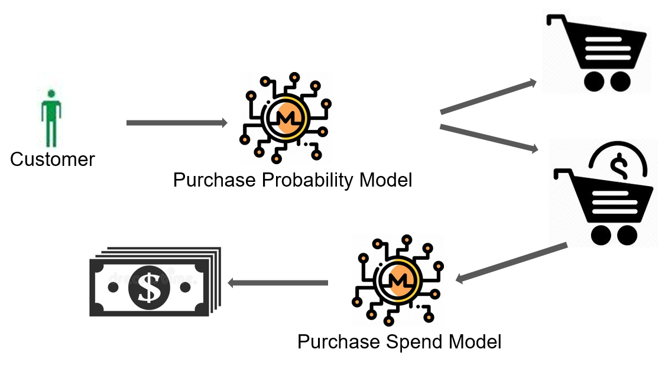
Part 2 - Models for predicting demand
Developing models for predicting demand
Make dataset from customer’s demographic and transactional data
Train Machine Learning Model (Supervised & Unsupervised)
Predicting whether customer will purchase in next day/ week/ month? (Classification Model)
How much customer will spend in his/ her next visit? (Regression Model)
Notes:
The Objective of this research
To forecast the construction of SFHs in United States, so that it guide construction business community about where to invest ahead of time. Past data can be used analyze complex patterns in SFHs construction across united states (US)
Once we get the prediction, now it is important to know the optimal locations where construction company build plants

Slide 26
Part 2 – Supervised Learning Technique
Model for Predicting Demand
Take Data for specific Time Frame (let say one year)
One Year Data
Data up to October
Data after October
Training Data
Testing Data
Machine Learning
Notes:
The Objective of this research
To forecast the construction of SFHs in United States, so that it guide construction business community about where to invest ahead of time. Past data can be used analyze complex patterns in SFHs construction across united states (US)
Once we get the prediction, now it is important to know the optimal locations where construction company build plants

Slide 27
Part 2 – Using Supervised Learning Technique
Model for Predicting Demand
For training data (till October), I will calculate some features such as
Number of Orders Placed by customer, Total revenue generated so far, Most bought items, Least bought Items, Average daily/ weekly/ monthly orders, Recency, Frequency
RFM Score for each customer ID
These features will be used for training Machine Learning Algorithm – X
For training data (after October), I will calculate following
Total Items Ordered by Customer - Y
Mathematical Model
Y = f(X)
Demand with next 2 months = f(features of last 10 months)
Notes:
The Objective of this research
To forecast the construction of SFHs in United States, so that it guide construction business community about where to invest ahead of time. Past data can be used analyze complex patterns in SFHs construction across united states (US)
Once we get the prediction, now it is important to know the optimal locations where construction company build plants

Slide 28
Part 2 – Using Unsupervised Learning Technique
Important Data
Customers’ Data( Name, Location, Age, rating)
Customers’ Transactional Data(Customer ID, Order Date and time, product line, product name, Product Price)
Deciding the time frame:- 6 months
Calculate Recency, Frequency and Monetary Value (we will call it Revenue from now on) and apply unsupervised machine learning to identify different segment groups (clusters) for each
Notes:
The Objective of this research
To forecast the construction of SFHs in United States, so that it guide construction business community about where to invest ahead of time. Past data can be used analyze complex patterns in SFHs construction across united states (US)
Once we get the prediction, now it is important to know the optimal locations where construction company build plants

Slide 29
Part 2 – Using Unsupervised Learning Technique
Calculate Recency
To calculate Recency, we need to find out most recent purchase date of each customer ID and see how many days they are inactive for.
After having no. of inactive days for each customer ID, we will apply K-means* clustering to assign customers a Recency score.
We will apply Elbow Method to tell how many clusters we need to K-means algorithm. To find it out, Elbow Method simply tells the optimal cluster number for optimal inertia(3 is the optimal one)
The customers in one Cluster will more recent compared to the others
Notes:
The Objective of this research
To forecast the construction of SFHs in United States, so that it guide construction business community about where to invest ahead of time. Past data can be used analyze complex patterns in SFHs construction across united states (US)
Once we get the prediction, now it is important to know the optimal locations where construction company build plants

Slide 30
Part 2 – Using Unsupervised Learning Technique
Calculate Frequency
To create frequency clusters, we need to find total number orders for each customer
We will apply K-means clustering to assign customers ID a frequency score and apply same logic to choose K value
As the same notation as Recency clusters, high frequency number indicates better customers
Calculating Revenue
We will calculate revenue for each customer, plot a histogram and apply the same clustering method as Frequency and Recency
Overall Score(RPM):-We have scores (cluster numbers) for Recency, frequency & revenue. Let’s create an overall score out of them
Notes:
The Objective of this research
To forecast the construction of SFHs in United States, so that it guide construction business community about where to invest ahead of time. Past data can be used analyze complex patterns in SFHs construction across united states (US)
Once we get the prediction, now it is important to know the optimal locations where construction company build plants

Slide 31
Part 2 – Using Unsupervised Learning Technique
Prediction RFM for next 6 months
After RFM scores for each customer ID , we will go ahead to implement it correctly by:-
Splitting our dataset. We will take 3 months of data, calculate RFM Score and use it for predicting next 6 months. So, we need to create two data frames first and append RFM scores to them.
After our feature set is ready, we calculate 6 months LTV for each customer ID which we are going to use for training our model.
Revenue becomes our LTV directly since there is no cost specified in the dataset.
Plot Histogram and check outliers
Merge our 3 months and 6 months data frames to see correlations between LTV and the feature set we have, plots LTV vs overall RFM score, High RFM score will mean high LTV
Notes:
The Objective of this research
To forecast the construction of SFHs in United States, so that it guide construction business community about where to invest ahead of time. Past data can be used analyze complex patterns in SFHs construction across united states (US)
Once we get the prediction, now it is important to know the optimal locations where construction company build plants

Slide 32
Important Note about LTV
Point to be Noted!
Before building the machine learning model, we need to identify what is the type of this machine learning problem. LTV itself is a regression problem. A machine learning model can predict the $ value of the LTV. But here, we want LTV segments. Because it makes it more actionable and easier to communicate with stakeholders. By applying K-means clustering, we can identify our existing LTV Segment groups.
Notes:
The Objective of this research
To forecast the construction of SFHs in United States, so that it guide construction business community about where to invest ahead of time. Past data can be used analyze complex patterns in SFHs construction across united states (US)
Once we get the prediction, now it is important to know the optimal locations where construction company build plants

Slide 33
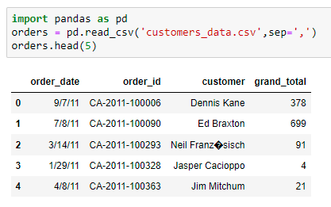
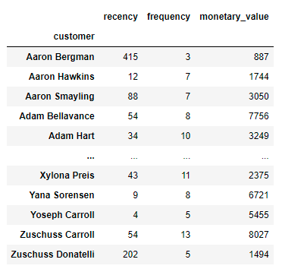
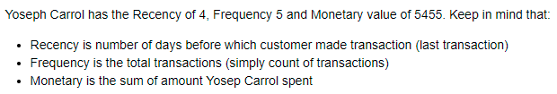
RFM Example – Dummy Data
Customer Segmentation
Notes:
The Objective of this research
To forecast the construction of SFHs in United States, so that it guide construction business community about where to invest ahead of time. Past data can be used analyze complex patterns in SFHs construction across united states (US)
Once we get the prediction, now it is important to know the optimal locations where construction company build plants

Slide 34
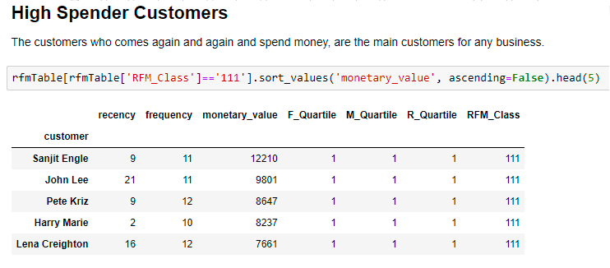
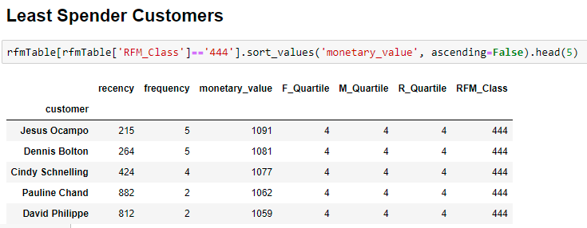
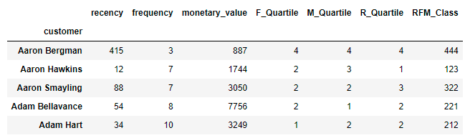
RFM Example – Dummy Data
Customer Segmentation
Notes:
The Objective of this research
To forecast the construction of SFHs in United States, so that it guide construction business community about where to invest ahead of time. Past data can be used analyze complex patterns in SFHs construction across united states (US)
Once we get the prediction, now it is important to know the optimal locations where construction company build plants

Slide 35

Possible Use Cases at Daily Harvest
Customer’s Churn Analysis
Customers due to issue can churn (leave you, go to your competitor) – You must know in advance
Data can help you to create an Early Warning System, which can raise alarm a head of time frame
This need customer transactional behavior, where we can make dataset
Training machine learning algorithm
Identify your loyal customers and customers at Risk
Notes:
The Objective of this research
To forecast the construction of SFHs in United States, so that it guide construction business community about where to invest ahead of time. Past data can be used analyze complex patterns in SFHs construction across united states (US)
Once we get the prediction, now it is important to know the optimal locations where construction company build plants

Slide 36
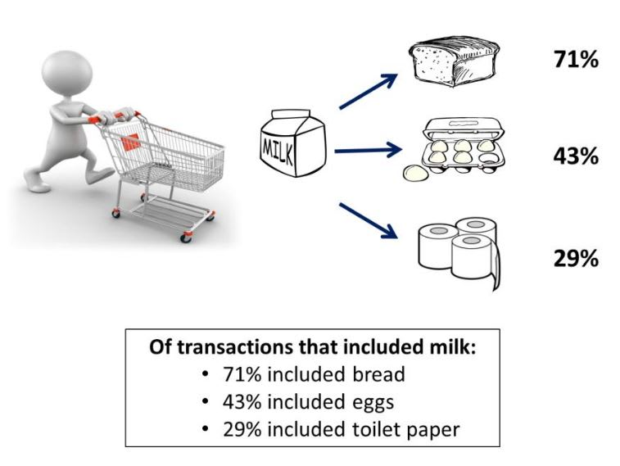
Possible Use Cases at Daily Harvest
Market Basket Analysis
Market basket analysis is a data mining technique can be used by Daily Harvest to increase orders by better understanding customer purchasing patterns. It involves analyzing large data sets, such as purchase history, to reveal product groupings, as well as products that are likely to be purchased together.
Notes:
The Objective of this research
To forecast the construction of SFHs in United States, so that it guide construction business community about where to invest ahead of time. Past data can be used analyze complex patterns in SFHs construction across united states (US)
Once we get the prediction, now it is important to know the optimal locations where construction company build plants

Slide 37
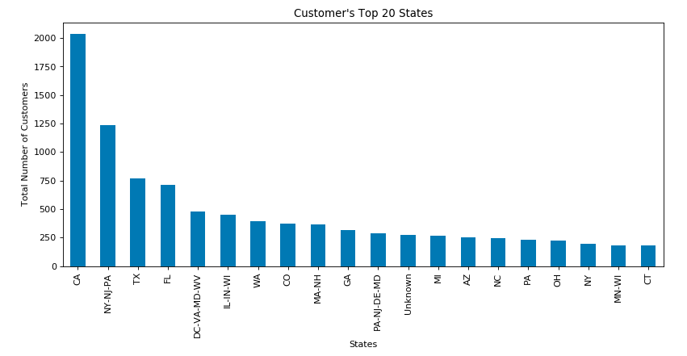
Working with your Data
Customer’s Address, Orders, Products
Notes:
The Objective of this research
To forecast the construction of SFHs in United States, so that it guide construction business community about where to invest ahead of time. Past data can be used analyze complex patterns in SFHs construction across united states (US)
Once we get the prediction, now it is important to know the optimal locations where construction company build plants

Slide 38
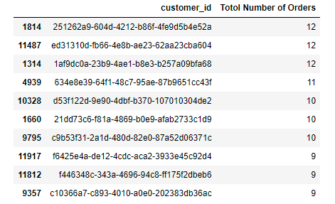
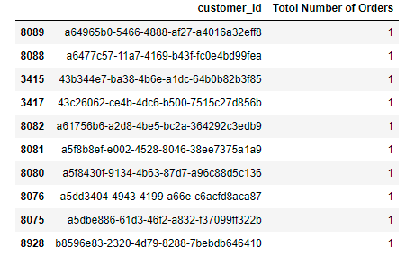
Working with your Data
Top 10 Customers – Maximum Orders & 10 Customers – Least Orders
Need to Maximize
Need to Minimize
Notes:
The Objective of this research
To forecast the construction of SFHs in United States, so that it guide construction business community about where to invest ahead of time. Past data can be used analyze complex patterns in SFHs construction across united states (US)
Once we get the prediction, now it is important to know the optimal locations where construction company build plants

Slide 39
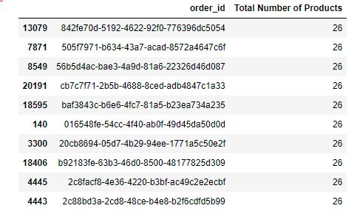
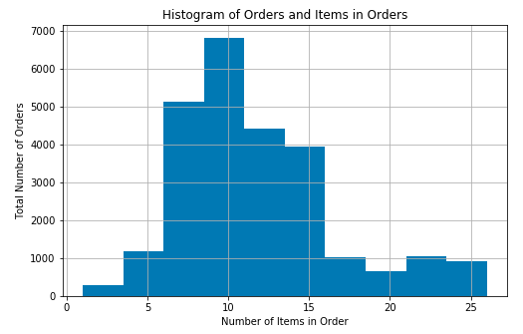
Working with your Data
Top 10 Orders – Maximum Items & 10 Orders – Least Items
Notes:
The Objective of this research
To forecast the construction of SFHs in United States, so that it guide construction business community about where to invest ahead of time. Past data can be used analyze complex patterns in SFHs construction across united states (US)
Once we get the prediction, now it is important to know the optimal locations where construction company build plants

Slide 40
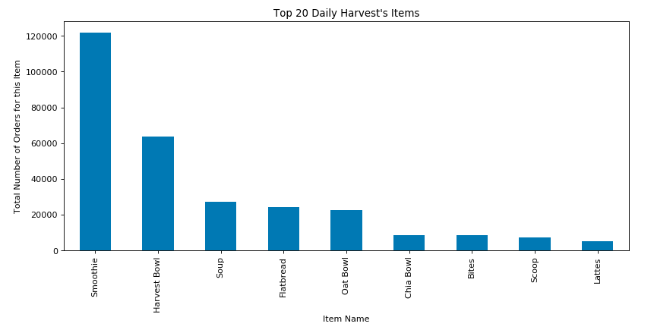
Working with your Data
Top 20 Daily Harvest’s Items
Notes:
The Objective of this research
To forecast the construction of SFHs in United States, so that it guide construction business community about where to invest ahead of time. Past data can be used analyze complex patterns in SFHs construction across united states (US)
Once we get the prediction, now it is important to know the optimal locations where construction company build plants

Slide 41
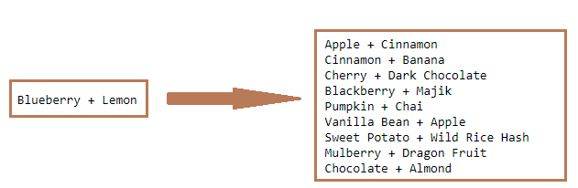
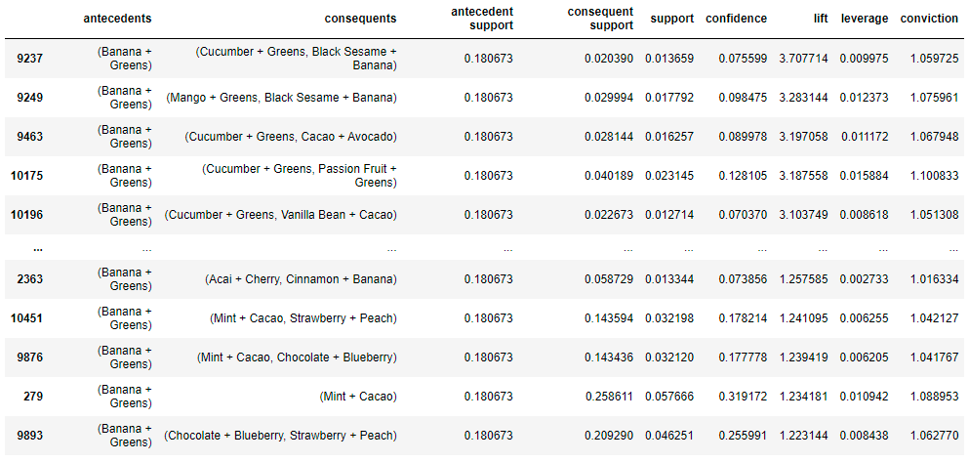
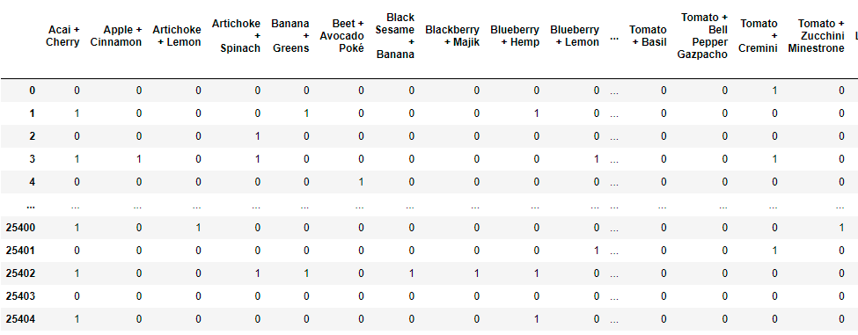
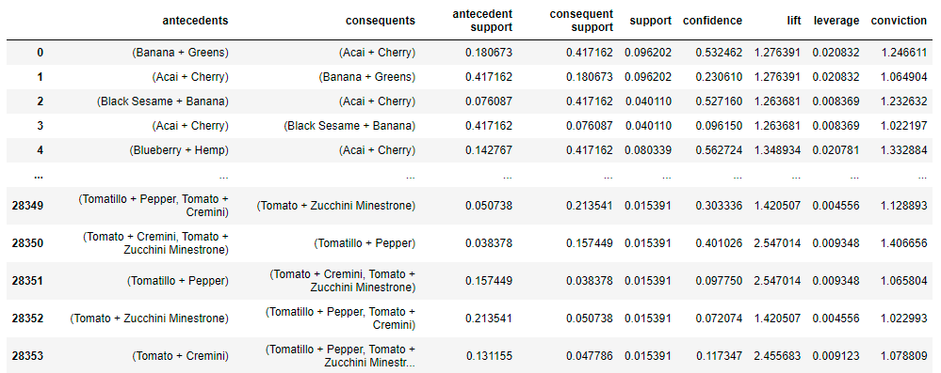

Working with your Data
Market Basket Analysis – Apriori Algo – Rule Mining Association
Top Association of Blueberry+Lemon with other Items Bought by Customers
Association of Banana+Greens with other Items Bought by Customers
Create Transactions Dataset
Association Between Items Bought by Customers
Notes:
The Objective of this research
To forecast the construction of SFHs in United States, so that it guide construction business community about where to invest ahead of time. Past data can be used analyze complex patterns in SFHs construction across united states (US)
Once we get the prediction, now it is important to know the optimal locations where construction company build plants

Slide 42

Conclusion
i
Notes:
The Objective of this research
To forecast the construction of SFHs in United States, so that it guide construction business community about where to invest ahead of time. Past data can be used analyze complex patterns in SFHs construction across united states (US)
Once we get the prediction, now it is important to know the optimal locations where construction company build plants

